Slide 1


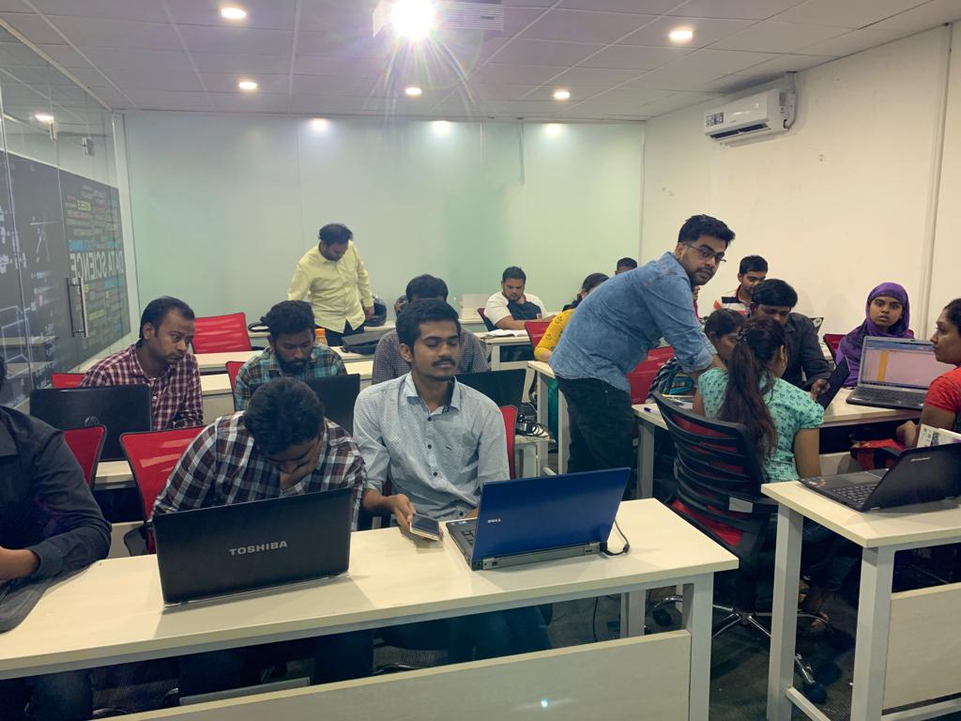

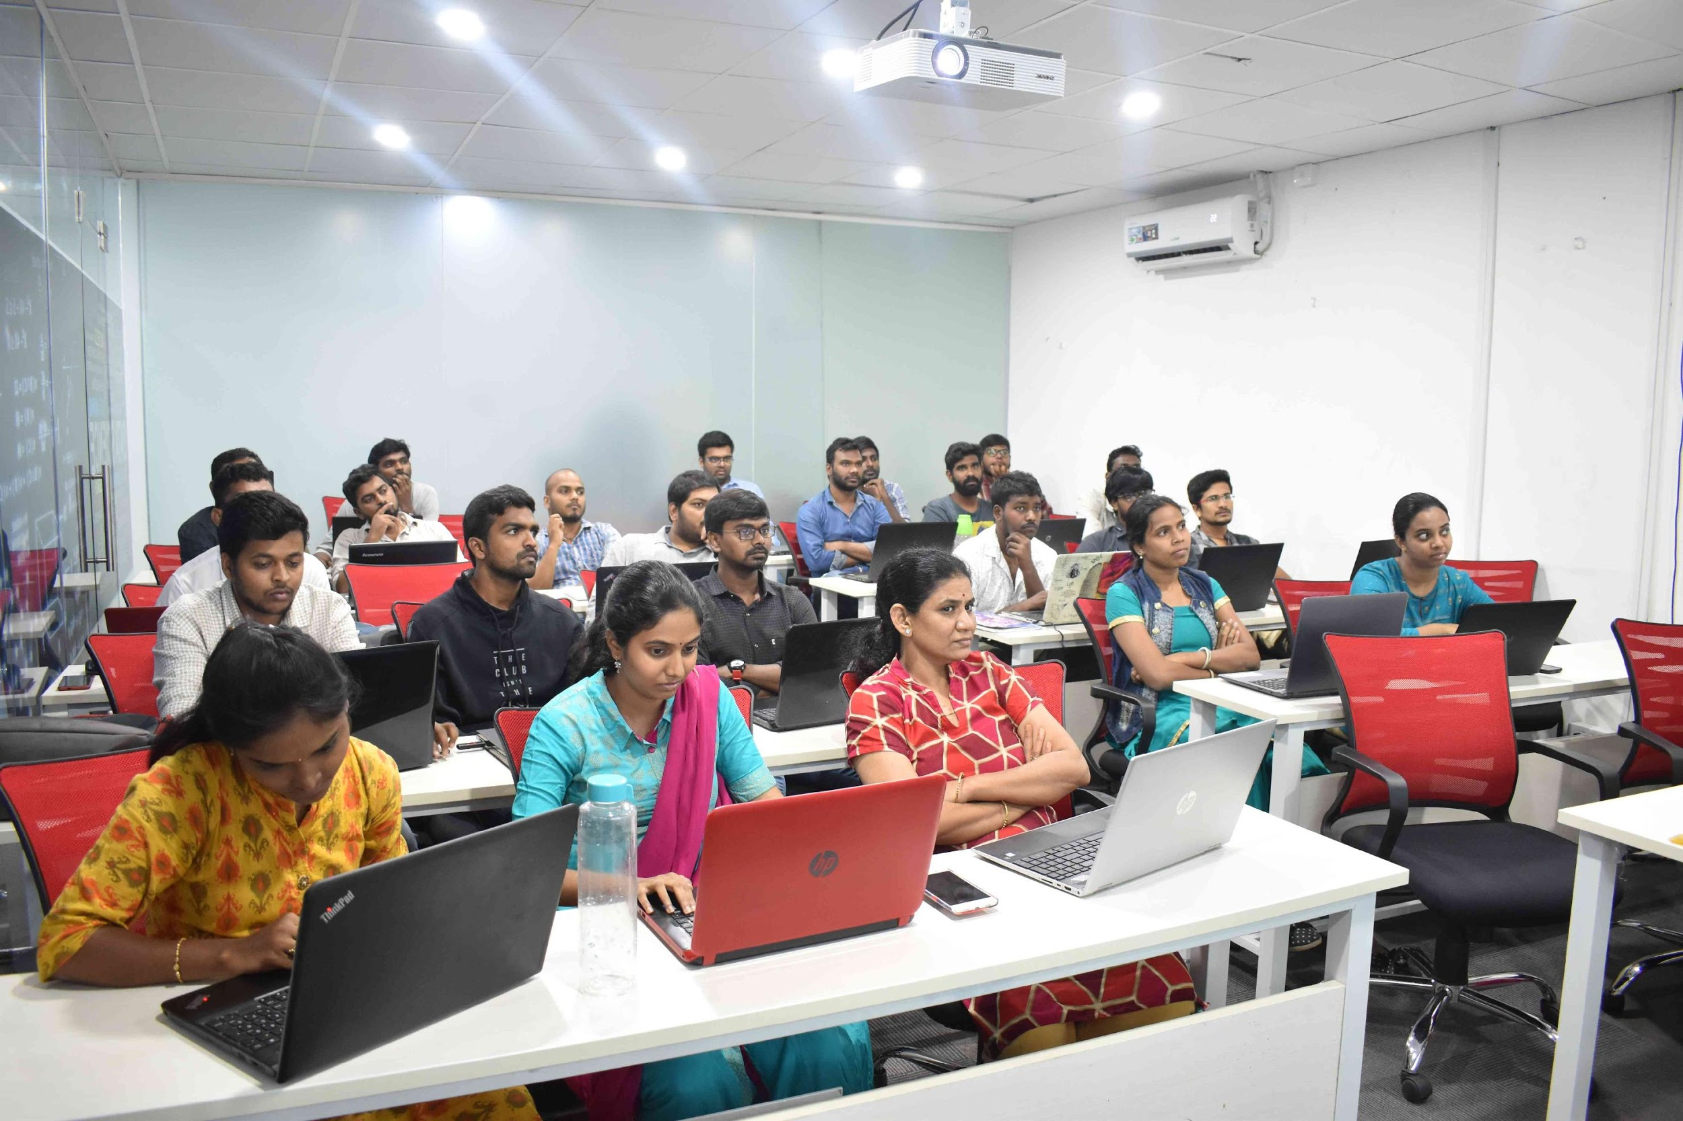



Slide 2
Web Scraping On Restaurant Data

Slide 3
About me
Background ? (B-tech or M-tech)
Why you want to learn Data Science
Any work experience

Slide 4
Data Science? And Why?

Slide 5
Web Scraping?

Slide 6
Problem Statement:
If we want to order food from online food delivery applications, we want to order it from best restaurant with some criteria i.e. cost, ratings and offers.
In this project, I have collected data from swiggy from five different locations in order find out which has lowest and highest cost, ratings and offers.

Slide 7
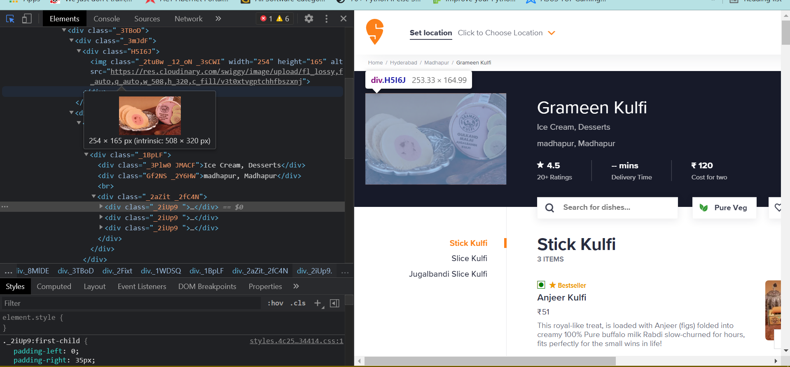
Collecting Data:

Slide 8
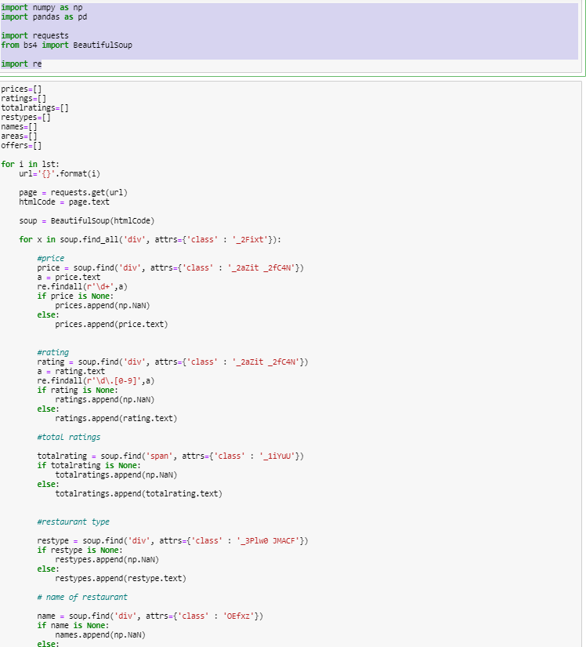
Scrapping the data:

Slide 9
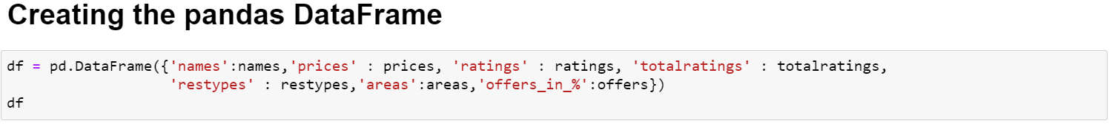
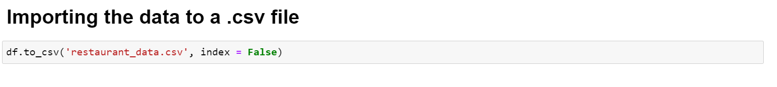
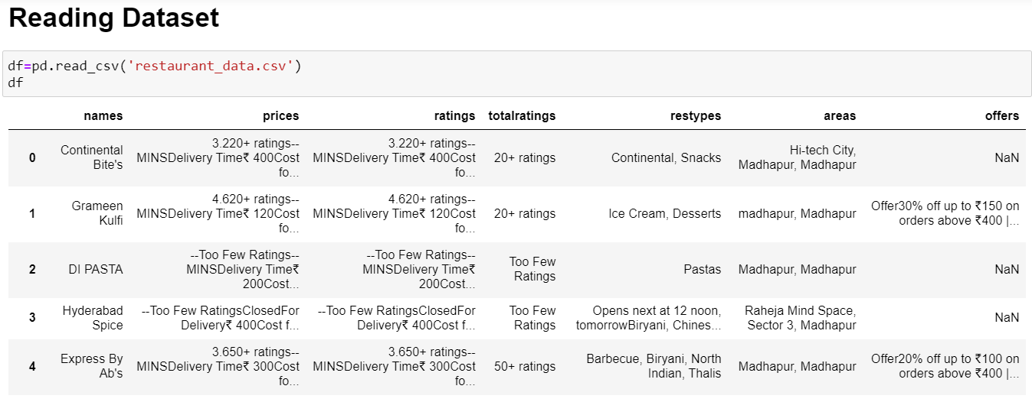
Creating Data frame and importing to csv file and reading csv:

Slide 10
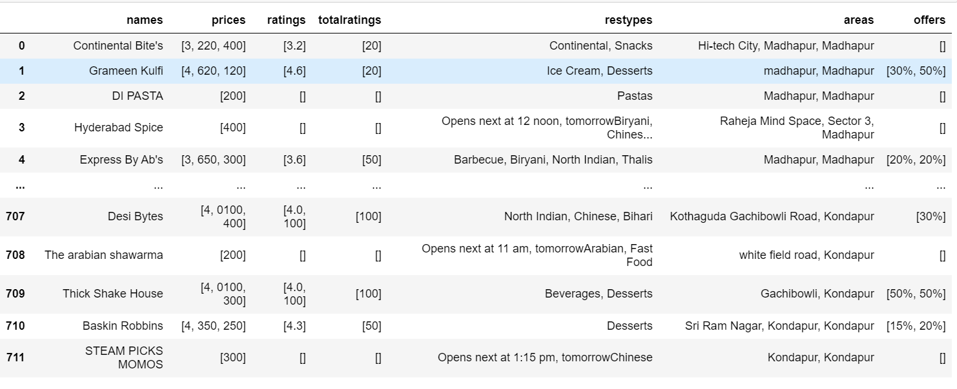
Extracting data using regex:

Slide 11
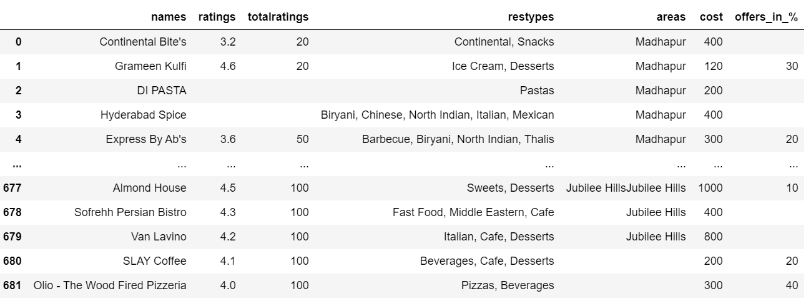
Cleaning Data:

Slide 12
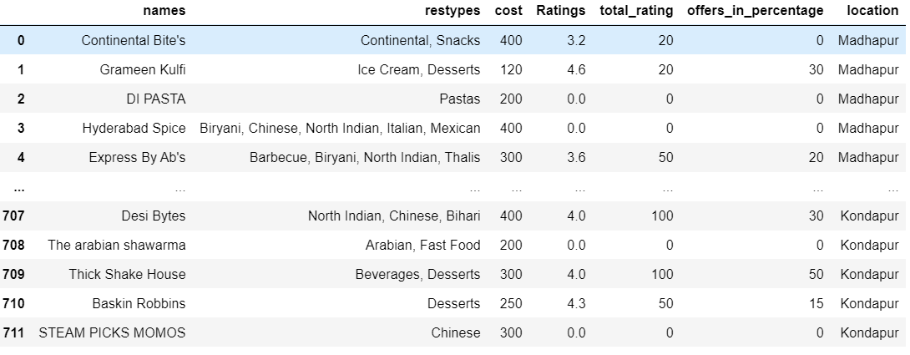
Treating Null Values:

Slide 13
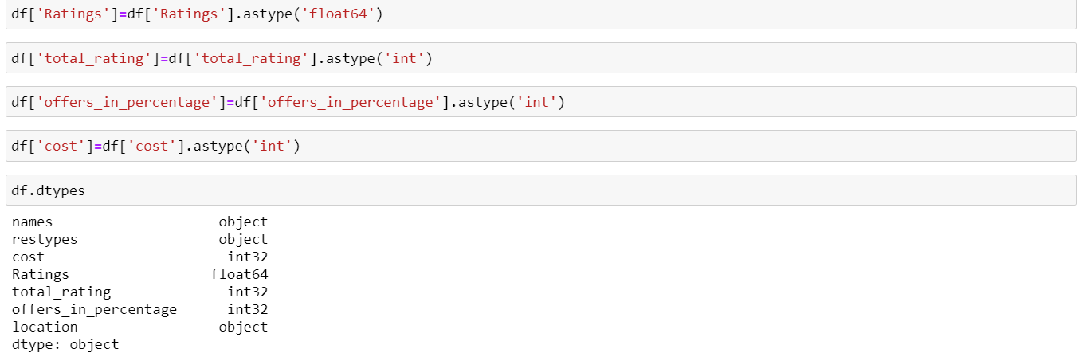
Typecasting:

Slide 14
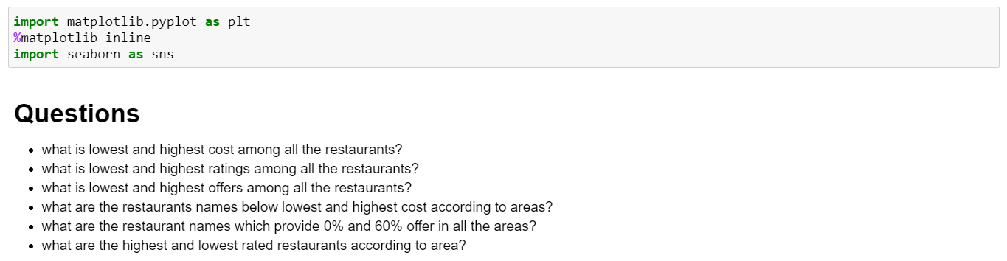
Data viz:

Slide 15
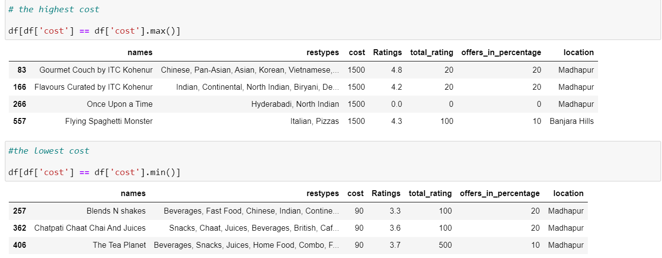
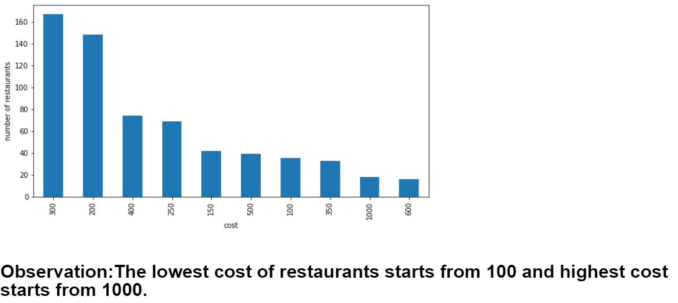
Univariate: The analysis of one variable.
Cost:

Slide 16
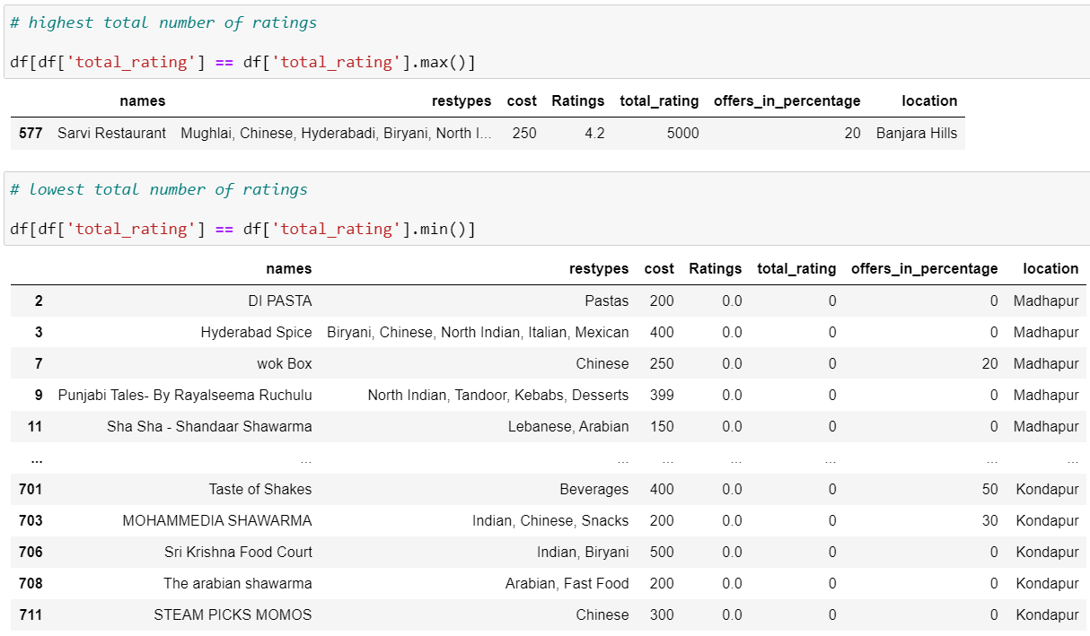
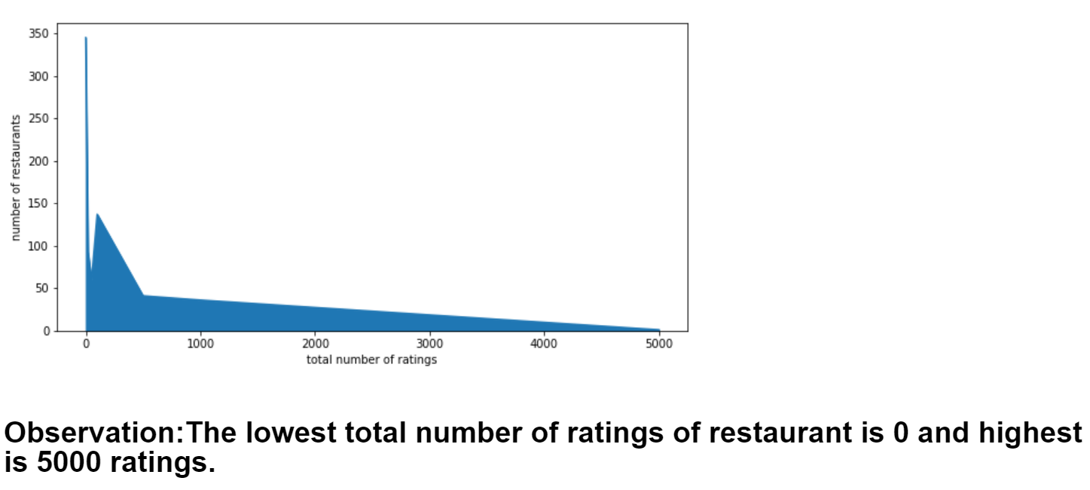
Total number of ratings:

Slide 17
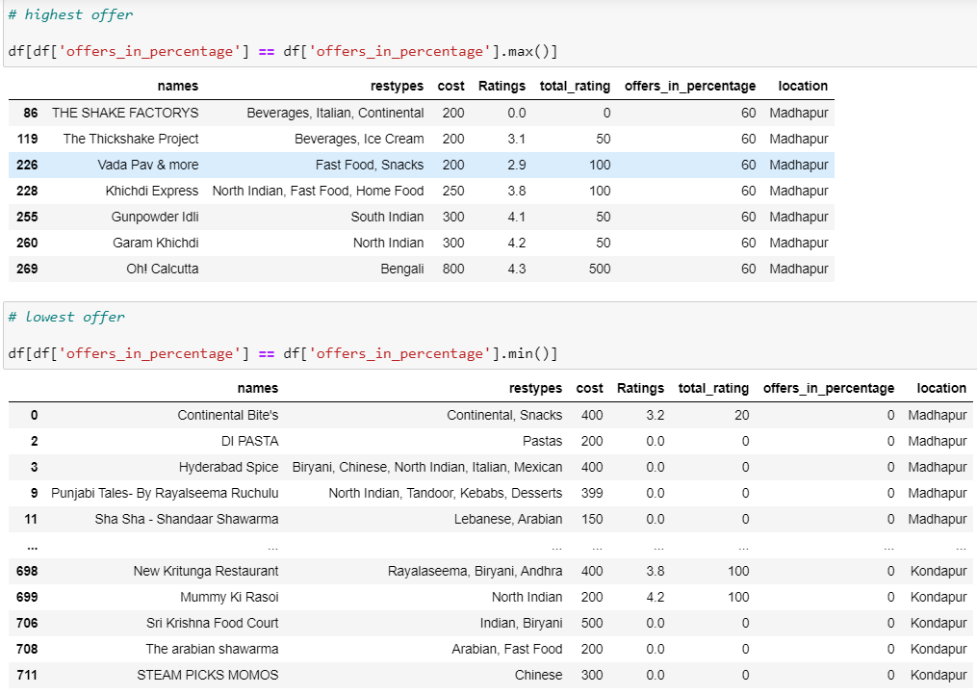
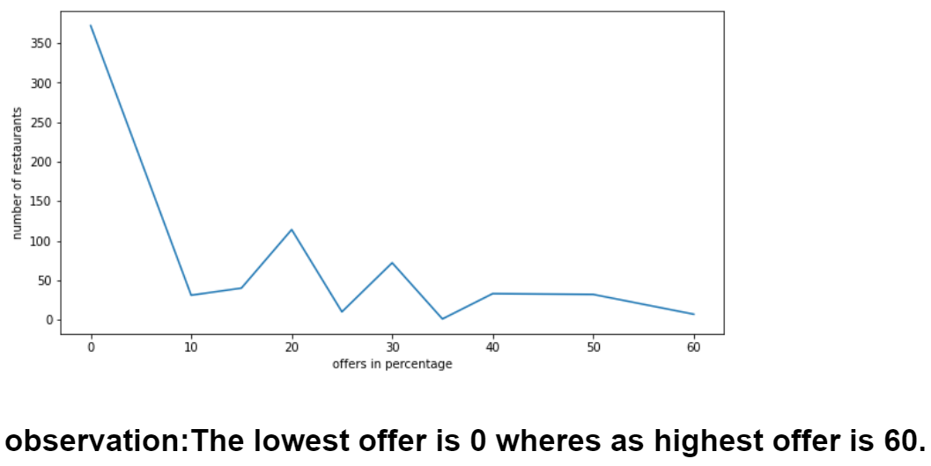
Offers:

Slide 18
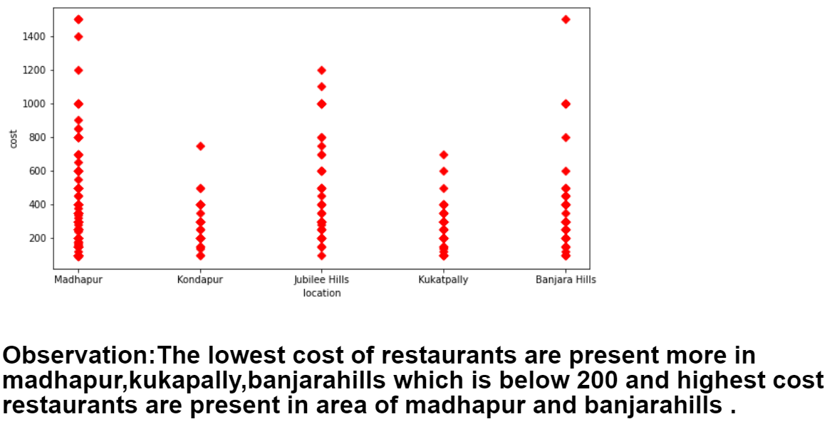
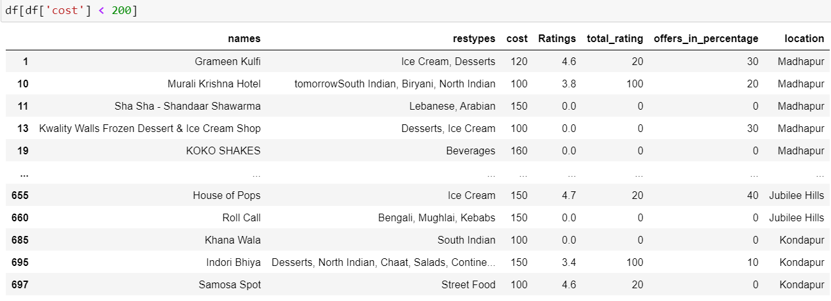
Bivariate: The analysis of two variables.
Restaurants below 200 cost area wise:

Slide 19
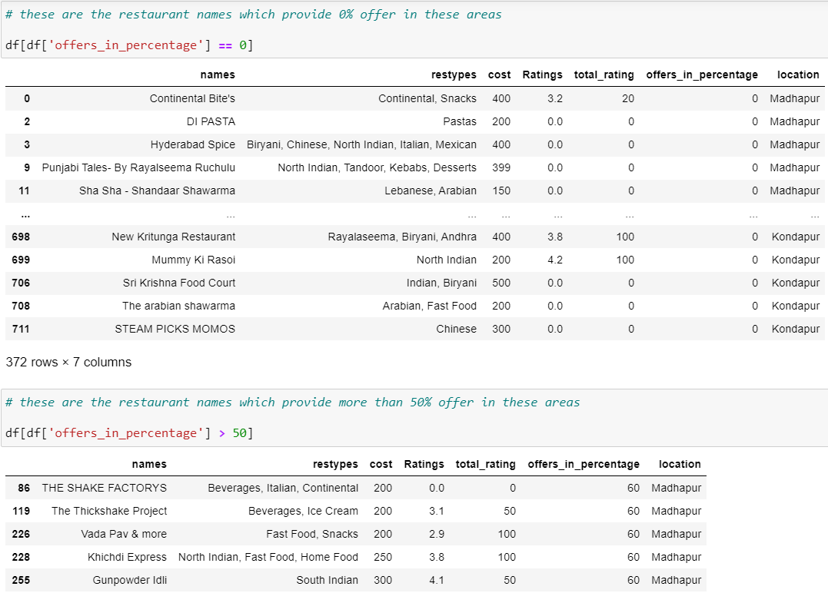
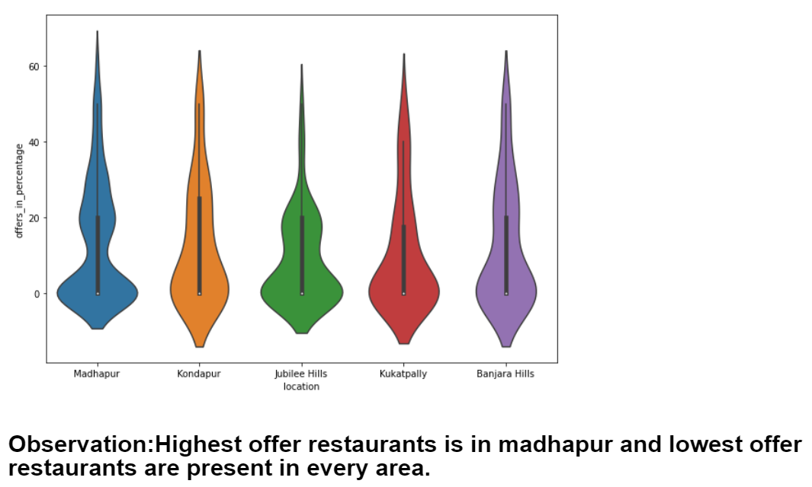
Restaurant which provide 0% and 50% offer area wise:

Slide 20
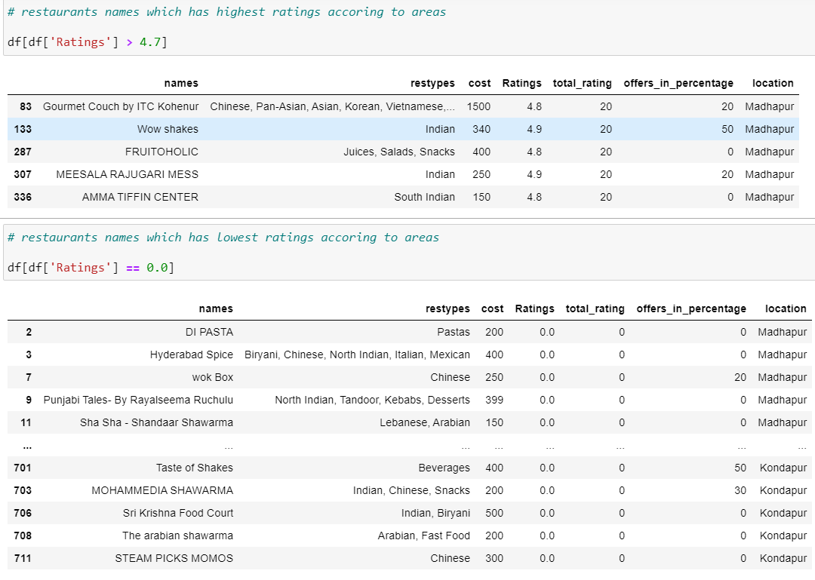
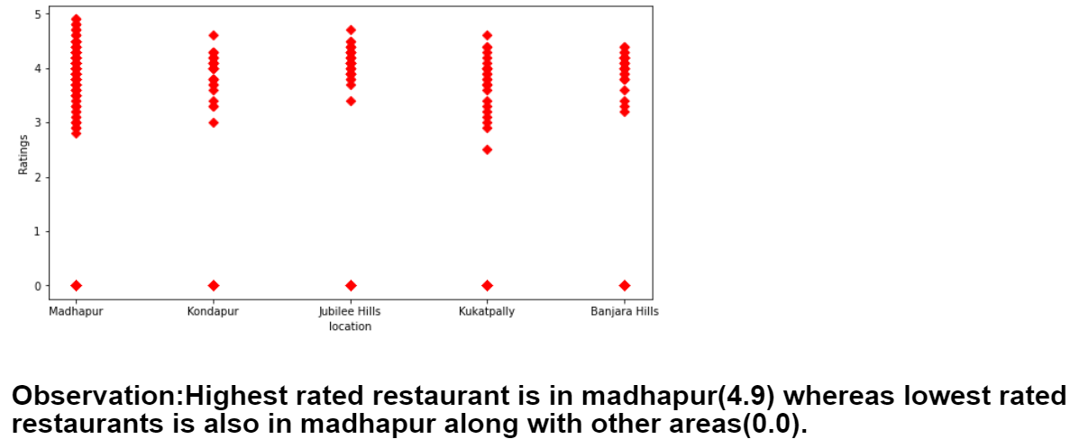
Restaurants which has highest and lowest ratings area wise:

Slide 21
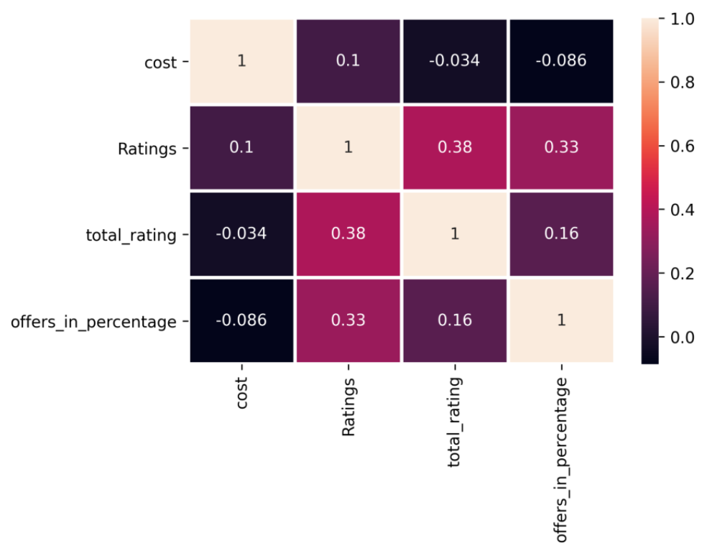
Multivariate: The analysis of two or more variables

Slide 22
Conclusion:
The lowest cost among all restaurants is 100 and highest cost is 1500.
The lowest rating among all restaurants is 0.0 and highest rating is 4.9.
The lowest offer is 0% while the highest offer is 60%.

Slide 23

THANK YOU

